Slide 1

Notes:
Cover Slide

Slide 2



INTRODUCTION
CRITICAL THINKING
(REBUS PUZZLES)

Slide 3
INTRODUCTION
A rebus puzzle is a representation of words or syllables by pictures of objects or by symbols whose names resemble the intended words or syllables in sound.
In general, rebus puzzles are riddles made up of such pictures, letters and symbolic representations meaning a different thing.

Slide 4
INTRODUCTION
WAYS TO SOLVE A REBUS PUZZLE :
A rebus puzzle checks the creativity and presence of mind of a candidate. There can be two easy methods followed to get a hint about the answer or even the answer itself. These are the two following ways as listed.
Considering the sound created by the syllable, or the words of the image.
Any arrow or indication to a specific part in an image is a hint.

Slide 5
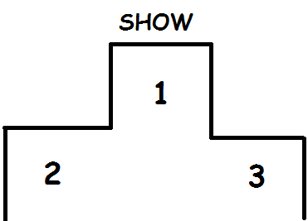
REBUS PUZZLES
Notes:
Answer: First Show

Slide 6

REBUS PUZZLES
Notes:
Answer: Inbox

Slide 7

REBUS PUZZLES
Notes:
Answer: Arctic Circle

Slide 8
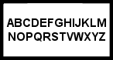
REBUS PUZZLES
Notes:
Answer: Missing U

Slide 9

REBUS PUZZLES
Notes:
Answer: Growing Economy

Slide 10

REBUS PUZZLES
Notes:
Answer: Win with ease

Slide 11

REBUS PUZZLES
Notes:
Answer: Hitting below the belt

Slide 12

REBUS PUZZLES
Notes:
Answer: Round Edges

Slide 13
REBUS PUZZLES
ADNST
Notes:
Answer: Stand in Alphabetical Order

Slide 14

REBUS PUZZLES
Notes:
Answer: Daimond Ring

Slide 15

REBUS PUZZLES
Notes:
Answer: What goes up Must comes down

Slide 16

REBUS PUZZLES
Notes:
Answer: Summer (Sum R)

Slide 17

REBUS PUZZLES
Notes:
Answer: Falling in Love

Slide 18

REBUS PUZZLES
Notes:
Answer: Street Corner

Slide 19

REBUS PUZZLES
Notes:
Answer: Piece (P’s) of Pumpkin Pie

Slide 20
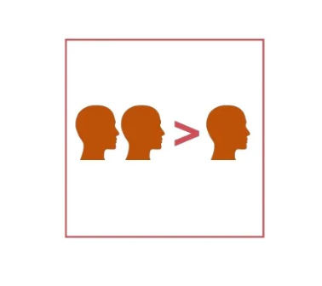
REBUS PUZZLES
Notes:
Answer: Two Heads are better than One

Slide 21
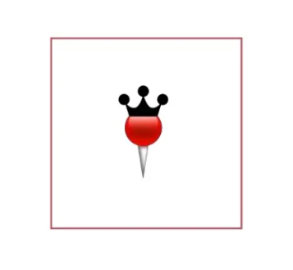
REBUS PUZZLES
Notes:
Answer: Kingpin

Slide 22
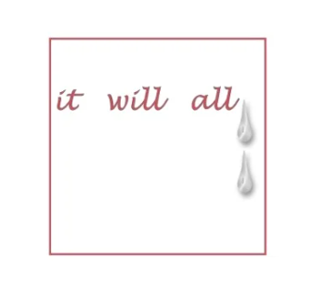
REBUS PUZZLES
Notes:
Answer: It will all end in tears

Slide 23
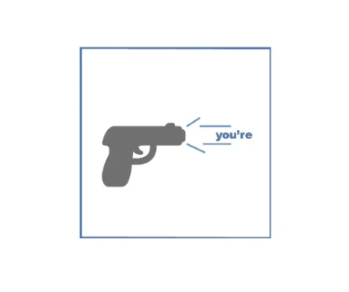
REBUS PUZZLES
Notes:
Answer: You’re fired

Slide 24
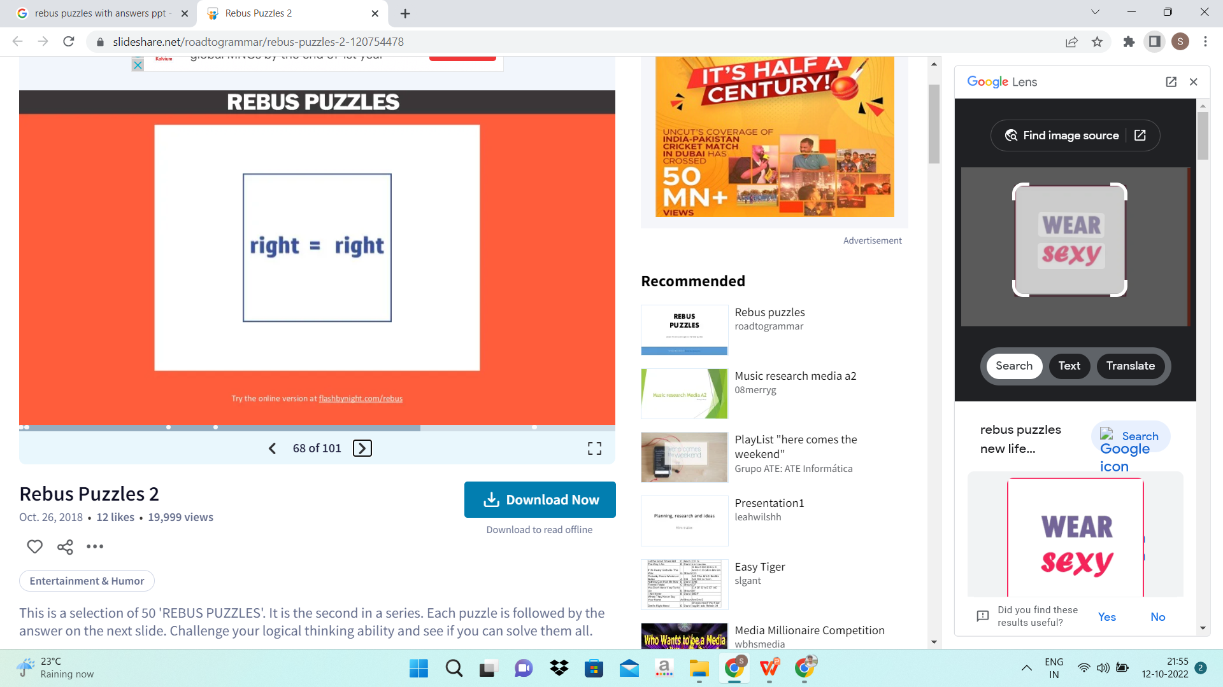
REBUS PUZZLES
Notes:
Answer: Equal Rights

Slide 25
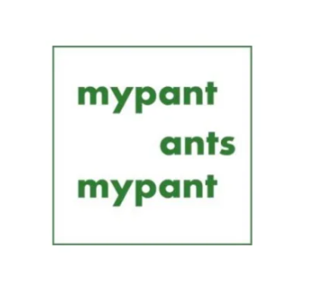
REBUS PUZZLES
Notes:
Answer: Ants in My pants

Slide 26
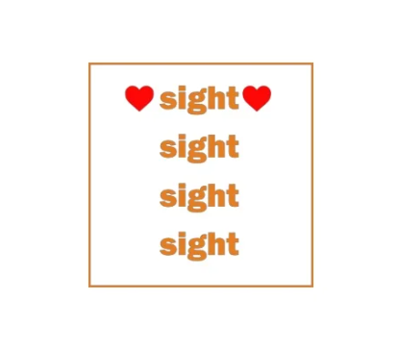
REBUS PUZZLES
Notes:
Answer: Love at First sight

Slide 27
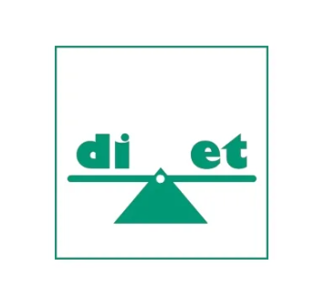
REBUS PUZZLES
Notes:
Answer: Balanced Diet

Slide 28
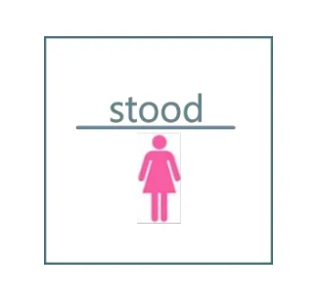
REBUS PUZZLES
Notes:
Answer: Misunderstood

Slide 29
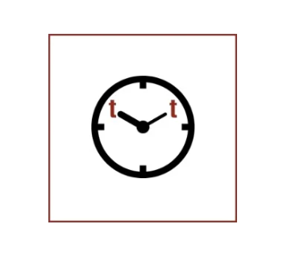
REBUS PUZZLES
Notes:
Answer: Tea Time

Slide 30
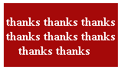
REBUS PUZZLES
Notes:
Answer: thanks a lot

Slide 31








/ethnuscodemithra
Ethnus Codemithra
/ethnus
/code_mithra
THANK YOU
https://learn.codemithra.com/
codemithra@ethnus.com
+91 7815 095 095
+91 9019 921 340

